Slide 1

GENDER AND AGE CLASSIFICATION
JATiN RAHEJA, PRATHEEK SIDDALINGIAH NARENDRA, SHAOCHENG SHI, Emily Gonzalez

Slide 2
PROJECT DESCRIPTION DATA AND GOALS
This project is called gender and age classification.
We are implementing various machine learning algorithms to accurately identify gander and age of the person in the taken image.
We are implementing logistic regression in this algorithm.
The goal is to take a random image of a human and determine the age and gender of the person.

Slide 3
PROJECT DESCRIPTION DATA AND GOALS
We have used 23704 images for training and testing the data.
The images all vary greatly in age for both genders.
The data for this project have been sourced from kagel

Slide 4
LOGISTIC REGRESSION
Logistic regression is an aspect of machine learning.
Logistic regression is implemented when there are multiple factors that derive the result.
It requires a massive sample size.
Logistic regression is a very powerful algorithm that compares training and testing variables
Provides a proper representation of the labels and features
It provides one of the most accurate results among the various machine learning algorithms.

Slide 5
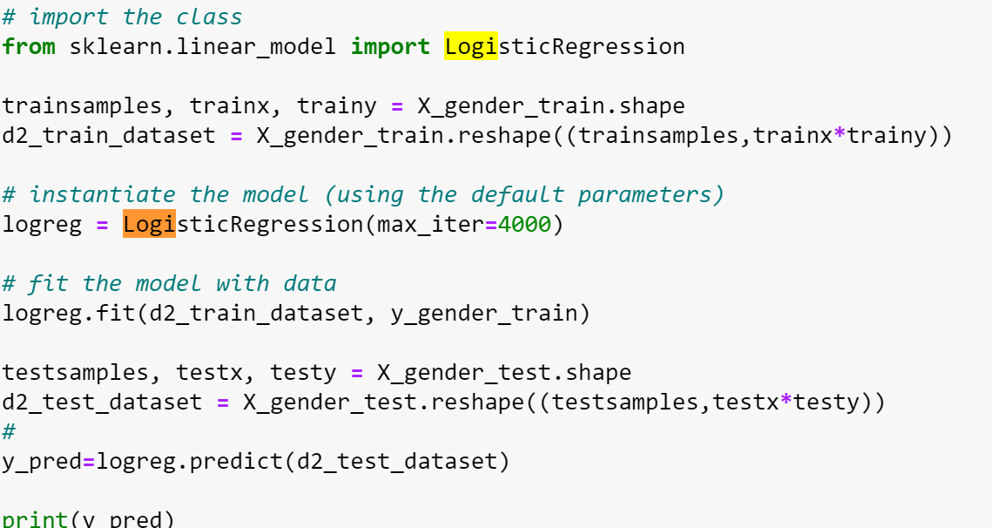
LOGISTIC REGRESSION

Slide 6
RESULT AND VISUALISATION
To achieve the best result we have thoroughly analysed each aspect of the code.
We have achieved an accuracy of 47% for age estimation
We have achieved an accuracy of 76.06% for gender estimation
It is extremely difficult to get a higher accuracy in age because of variables ethnic differences and other issues.

Slide 7
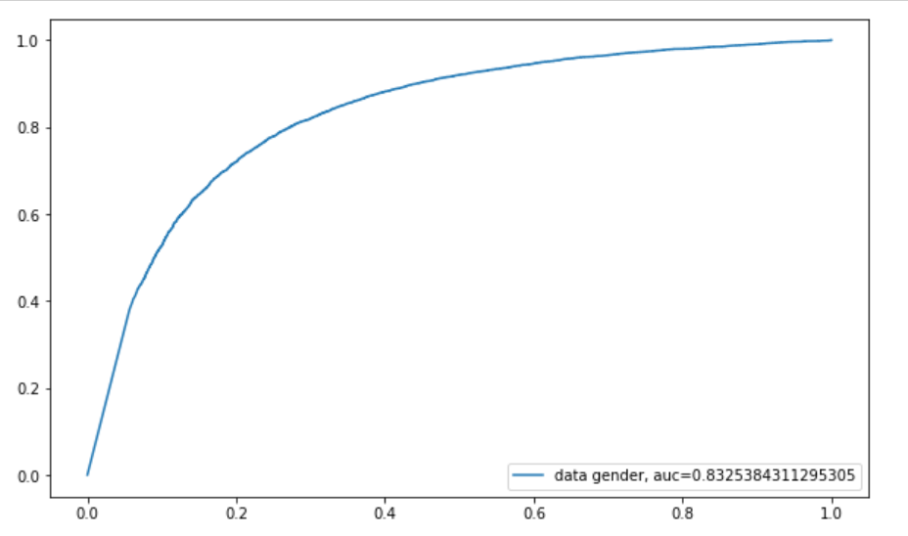
VISULATION

Slide 8
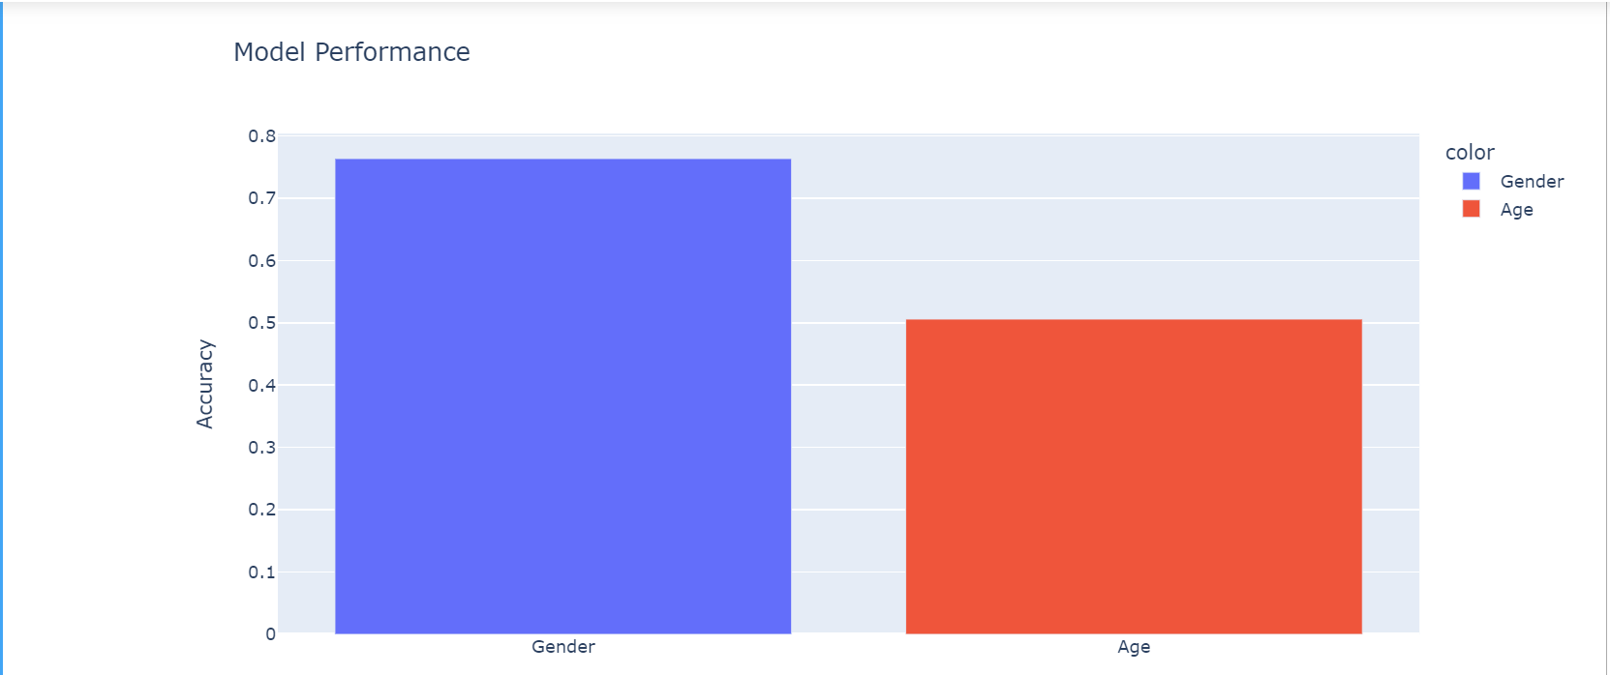
VISUALISATION

Slide 9
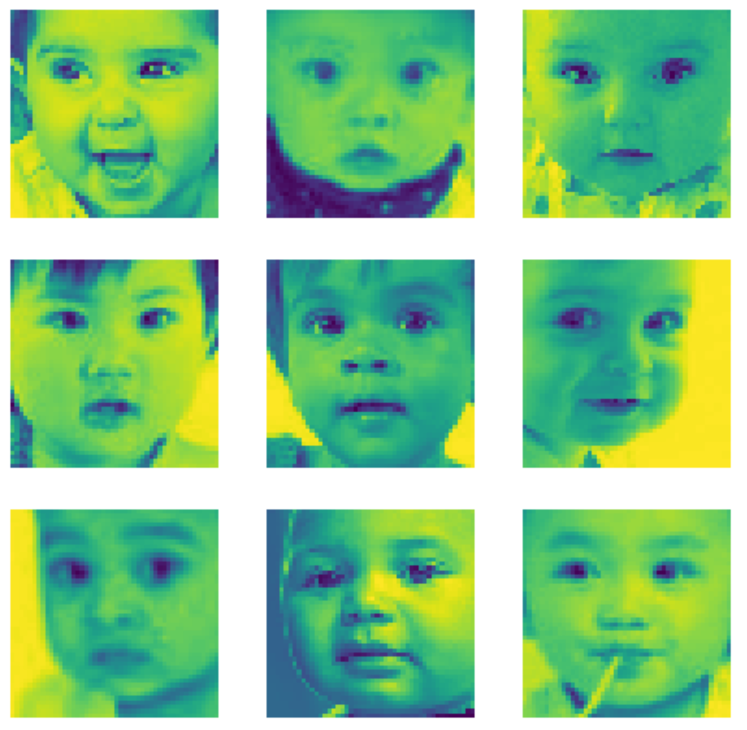
VISULATION

